Slide 1

Investigating aggregating and disaggregating α-synuclein cell models of Parkinson’s Disease
Tommy Patton
PhD candidate
University of Galway, Ireland

Slide 2
FN075 Structure
Synthetic small molecule peptidomimetic
  Dihydro thiazolo ring-fused 2-pyridone core
Free carboxylic acid with a peptide-like backbone
  Mimic a C-terminal β-sheet peptide
Target macromolecular assembly via protein-protein interactions
Naphthyl and CF₃-phenyl groups mimic hydrophobic side chains
  Allow targeting of β-sheet hydrophobic regions
(Åberg et al., 2005; Horvath et al., 2012)

Slide 3
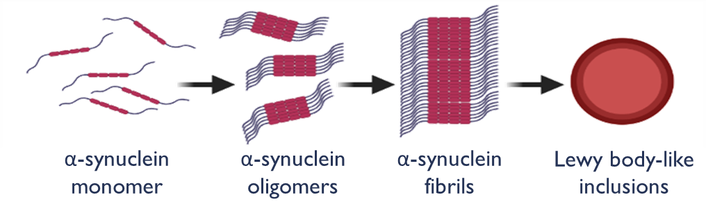

FN075 Mechanism
FN075 binds to α-synuclein monomers and accelerates their conversion into fibrillar aggregates
Effectively promoting α-synuclein pathology
Produce sensorimotor impairments & dopaminergic degeneration in mice
This pro-aggregating activity makes FN075 a useful research tool for studying the mechanisms of α-synuclein toxicity and for developing PD models
(Horvath et al., 2012; Chermenina et al., 2015)

Slide 4
Disaggregating compounds
Targeting pathogenic α-synuclein could potentially slow disease progression
Notes:
These organisms success can be attributed to their ability to modulate their host immune response through their secretome
inhibiting endolysosomalacidification in macrophages

Slide 5
Aim
Investigate FN075 as a tool for in vitro
modelling of α-synuclein aggregation
Secondly do the novel disaggregating compounds have therapeutic potential to prevent aggregation in vitro

Slide 6
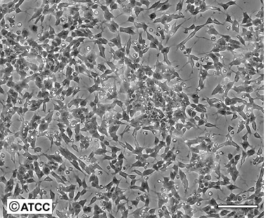
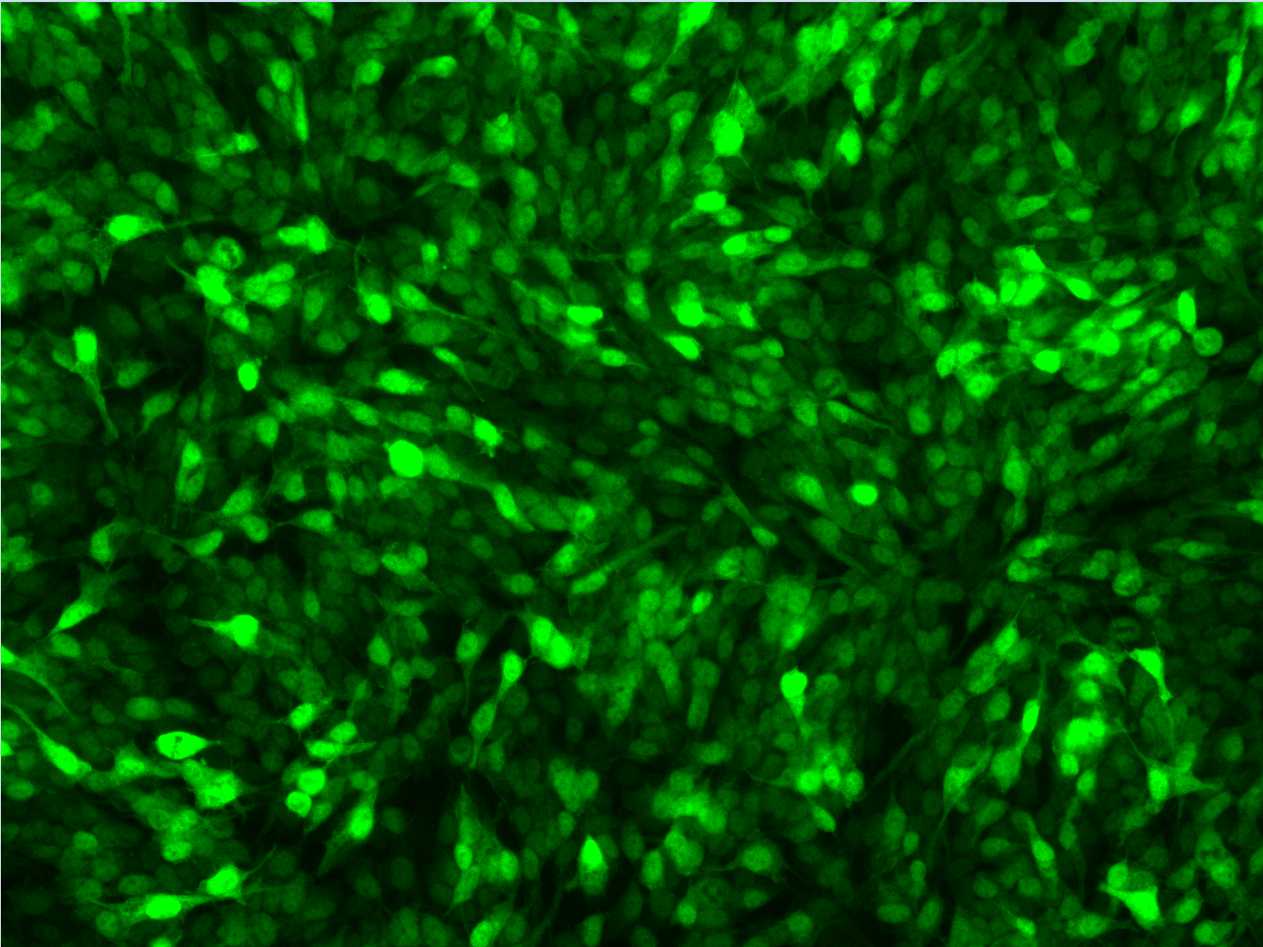
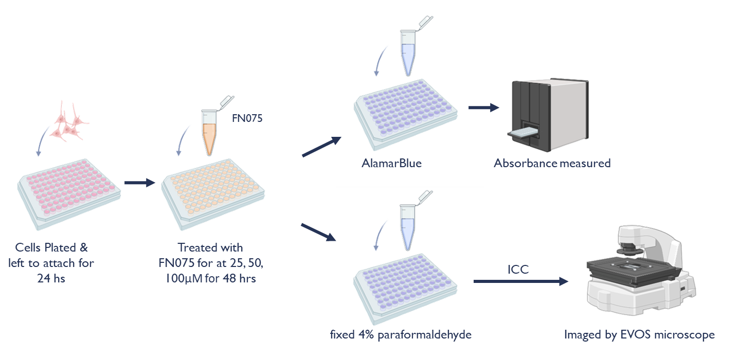
Methods
SH-SY5Y neuroblastoma cell line possess dopaminergic neuron-like properties
SH-SY5Y cell line that have been genetically altered through stable transfection with TagGPF2-α-synuclein
Toxicity
α-synucleinopathy

Slide 7
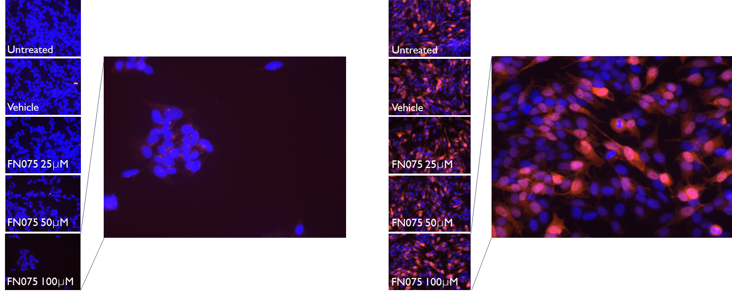
Aggregated α-synuclein
Regular SH-SY5Y
α-synuclein overexpressing cells
Notes:
These organisms success can be attributed to their ability to modulate their host immune response through their secretome
inhibiting endolysosomalacidification in macrophages

Slide 8
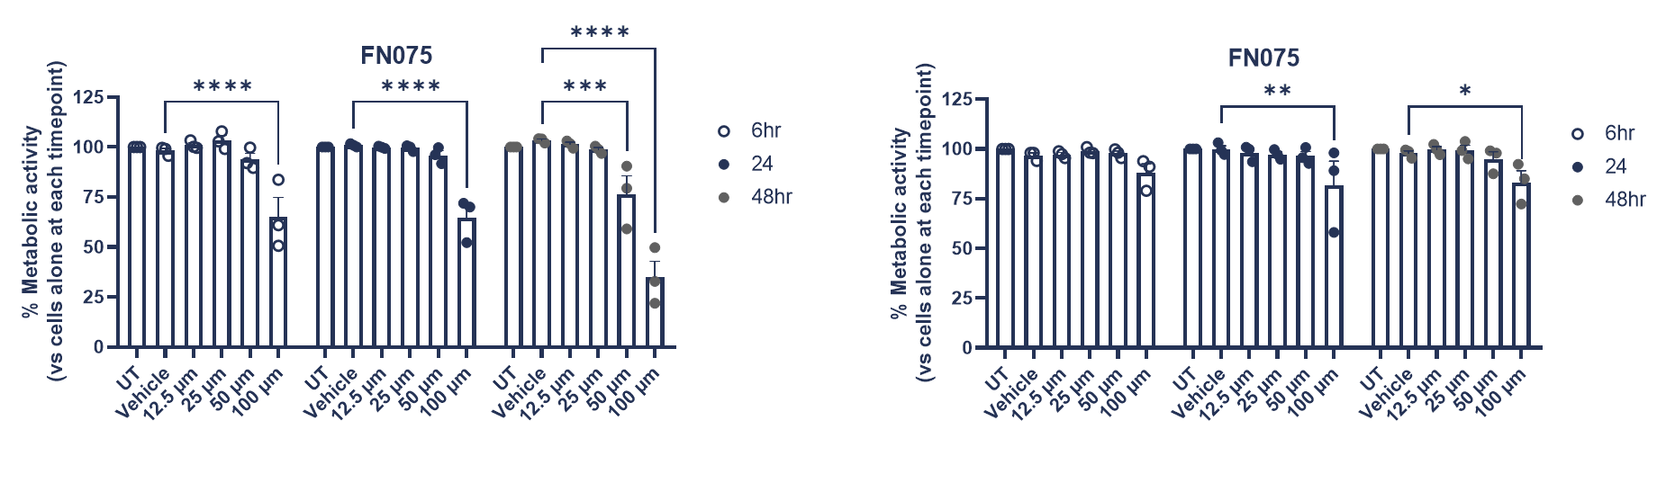
Cytotoxicity of FN075
Regular SH-SY5Y
α-synuclein overexpressing cells
FN075 at 50 & 100 μm significantly reduce cell viability over 48 hrs
FN075 at 100 μm significantly reduce cell viability over 48 hrs
Notes:
These organisms success can be attributed to their ability to modulate their host immune response through their secretome
inhibiting endolysosomalacidification in macrophages

Slide 9
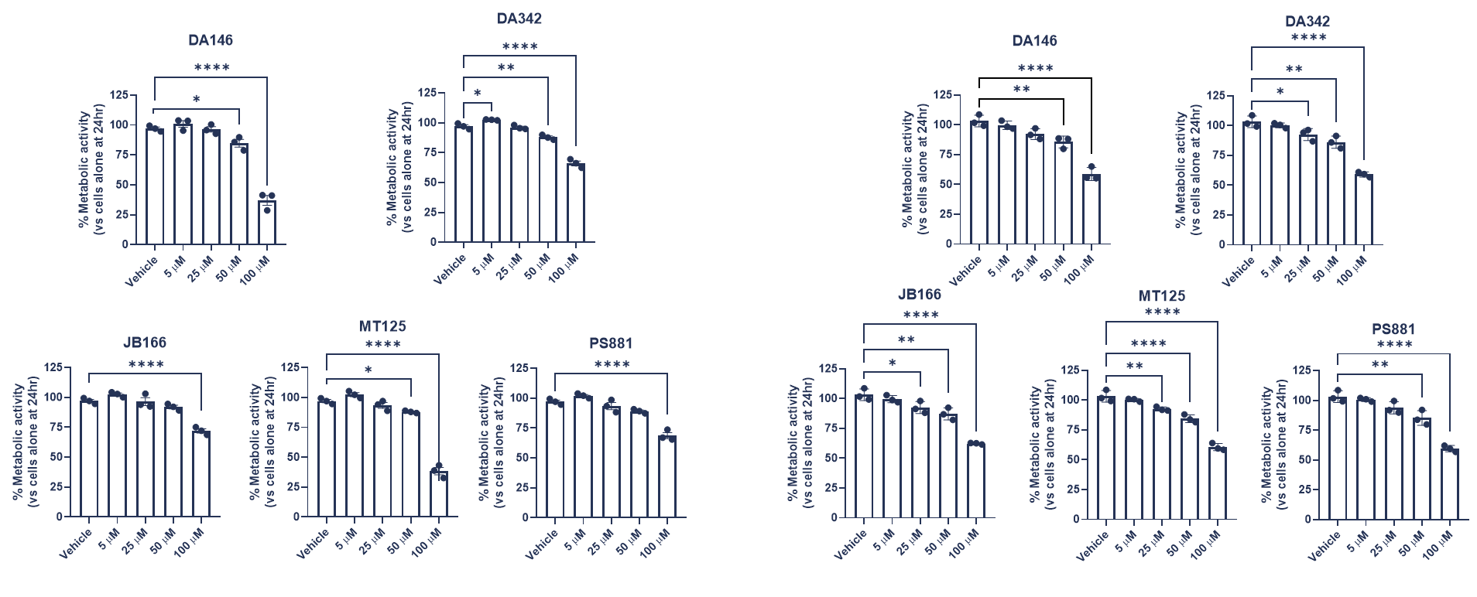
Disaggregating compounds cytocompatibility
Regular SH-SY5Y
α-synuclein overexpressing cells
Alamar blue assays were conducted to identify non-toxic concentrations
Notes:
These organisms success can be attributed to their ability to modulate their host immune response through their secretome
inhibiting endolysosomalacidification in macrophages

Slide 10
Disaggregating compounds vs FN075 toxicity in SH-SY5Y cells
25 µm or 50 µm 1 hr pre-treatment with DC
100 µm FN075 of 48 hours
Notes:
These organisms success can be attributed to their ability to modulate their host immune response through their secretome
inhibiting endolysosomalacidification in macrophages

Slide 11

Future plans
FN075 has potential as a tool for modelling PD in vitro
Quantification of its aggregation ability in SH-SY5Y cells is required
Test on differentiated cells with dopaminergic phenotype
Identification of synergistic effects with other parkinsonian insults
Further investigation of disaggregating compounds warranted
Timing window if compounds given post FN075
Do they reduce/prevent aggregation in a PD cell model
Off target toxicity- inflammatory markers, oxidative stress?
If any protective effects against other parkinsonian insults

Slide 12

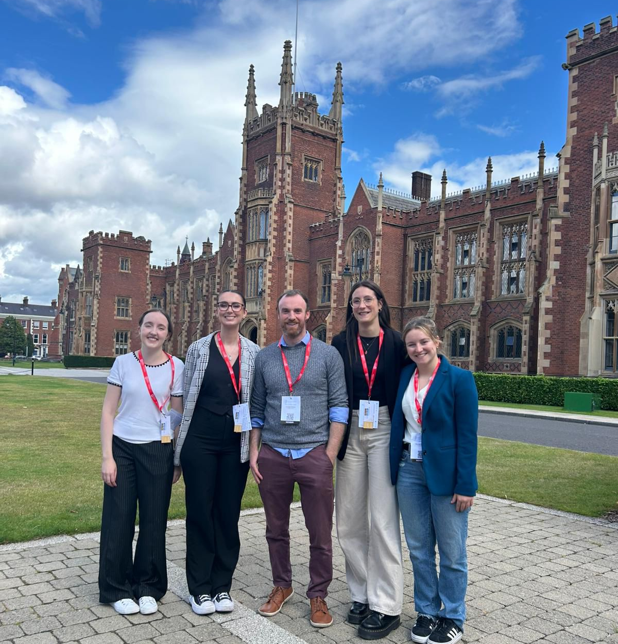


Acknowledgements
Prof Eilís Dowd
Dr Declan McKernan
Dr Giulia Comini
Ms Saoirse Ryan
Ms Sarah Crudden
Ms Sienna Stucke
Ms Robyn Gaffey
Dr Danny Kerr
Dr Claire Feerick
Dr Erin Molloy
Dr Andrew Cairns
Dr Jörgen Ådén
Prof Fredrik Almqvist

